Slide 1
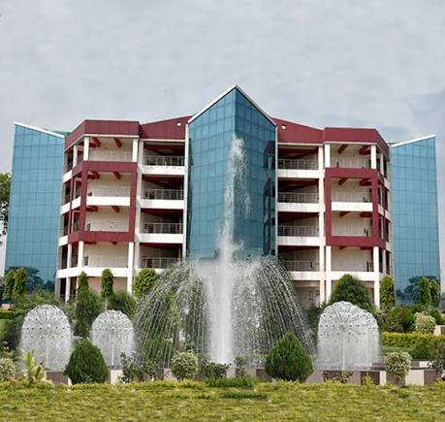




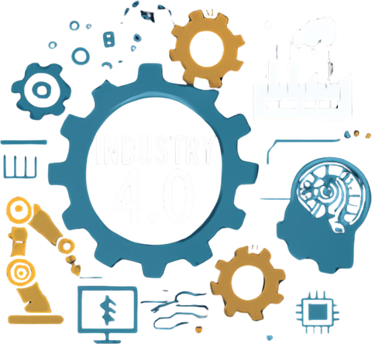
INDUSTRY 4.0
ENGINEERING DAY • 14 SEPTEMBER
“ENGINEERING
THE FUTURE”
Technology, Entrepreneurship
& Digital Transformation
Presented by
SHIVAM KUMAR
Diploma in Mechanical Engineering • 1st Semester
Roll No. 87263007 • NSIT, Bihta, Patna
Guidence of Saurab sir
College background photo supplied by student

Slide 2


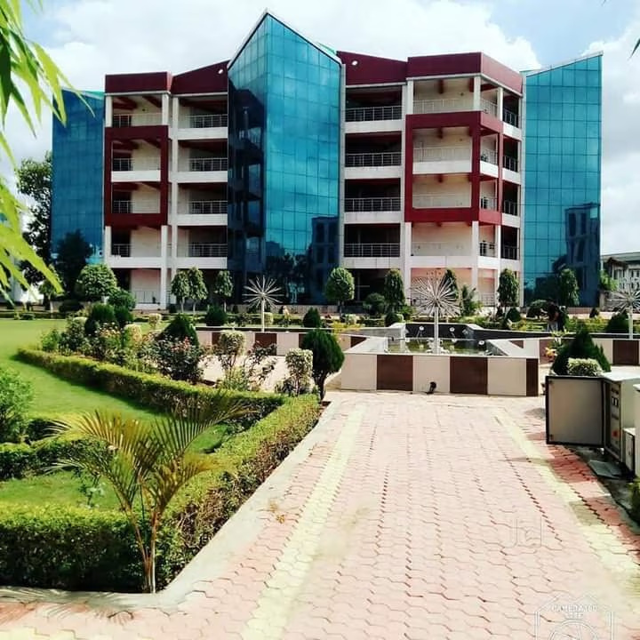
First, a little about NSIT
Starting with our college makes the project feel personal.
01
Established
02
Location
NSIT was established in 2007 at Amhara, Bihta, Patna.
About 2 km from Bihta Railway Station; Bihta is an emerging industrial hub.
03
Education
04
Campus
Engineering degree and diploma programmes, including Mechanical Engineering.
Official information highlights Wi-Fi, computer centre and digital library facilities.
Why it connects to Industry 4.0
Mechanical engineers work with machines, production and maintenance.
Industry 4.0 adds sensors, data, automation and smarter decisions.
Our learning can grow from workshop skills to digital skills.
Engineering Day • Industry 4.0
2

Slide 3
What is Industry 4.0?
A simple definition for a first-semester presentation.
Industry 4.0 refers to the fourth industrial revolution, where modern digital technologies are used to make industries smarter, more connected, automated, and efficient.
Sensors
Data
SMART
INDUSTRY
AI & ML
Automation
Goal: better quality • less downtime • safer work • smarter decisions
Engineering Day • Industry 4.0
3

Slide 4
How industry evolved?
Four revolutions — from steam power to smart systems.
1
Industry 1.0
2
3
Industry 2.0
Industry 3.0
4
Industry 4.0
Steam & water power
Mechanisation
Began in the late 18th century
Electricity & assembly lines
Mass production
Electronics & computers
Automation
IoT, AI & data
Smart production
Cloud computing
Industry 4.0 does not replace engineering basics — it makes them more connected and measurable.
Engineering Day • Industry 4.0
4

Slide 5
Technology toolbox of Industry 4.0
These are the building blocks behind smart factories.
•
IoT(Internet of thing)
•
AI / ML
•
Robotics
•
Cloud
Sensors + connected machines
Patterns, prediction, decisions
Repeatable and precise work
Access data and services
•
•
•
•
Big Data
Digital Twin
3D Printing
Cybersecurity
Large-scale production data
Virtual model of a machine
Fast prototyping and custom parts
Protect machines and data
Engineering Day • Industry 4.0
5

Slide 6
Industry 4.0 for Mechanical Engineering
Where our diploma subjects meet modern manufacturing.
⚙
Predictive maintenance
⚙
CNC + automation
⚙
Digital twin
Use vibration, temperature or current data to spot problems early.
Combine machining knowledge with sensors, controllers and robotics.
Study a virtual model before changing the real machine.
⚙
Smart quality
⚙
Energy monitoring
⚙
Safer workplaces
Use cameras and data to detect defects consistently.
Measure power use and reduce unnecessary energy loss.
Use automation and alerts for risky or repetitive tasks.
Engineering Day • Industry 4.0
6

Slide 7
Applications Of Industry 4.0
Industry 4.0 is used across many sectors.
⚙
Manufacturing
⚙
Healthcare
⚙
Automotive
  Automated production
  Quality Control
  Predictive maintenance.
  Smart medical device
  Remote monitoring
  Data-based diagnosis
  Robotic assembly
  Connected vehicles
  Digital manufacturing
⚙
Agriculture
⚙
Logistics
  Smart irriigation
  Crop monitoring
  Automated farming
  Smart Warehouses
  GPS tracking
  Automated inventory management
Student mindset: identify a problem → build a small solution → test → improve.
Engineering Day • Industry 4.0
7

Slide 8
Digital transformation: from traditional to smart
The change is not only about machines — it is also about decisions.
A
Traditional workshop
B
Smart workshop
• Sensor-based inspection
• Predictive maintenance
• Digital records
• Connected machines
• Decisions from data + experience
• Manual inspection
• Reactive maintenance
• Paper records
• Separate machines
• Decisions from experience
→
Same engineering fundamentals — smarter visibility, timing and control.
Engineering Day • Industry 4.0
8

Slide 9
A simple smart-factory example
Example: detecting an abnormal motor condition before failure.
1
2
3
4
5
SENSE
CONNECT
ANALYZE
PREDICT
ACT
Temperature / vibration
Send readings
Find unusual pattern
Estimate risk
Inspect or service
Sensor
IoT / network
Data / AI
Dashboard
Engineer
Result: less unexpected downtime + better planning + safer maintenance.
MEASURE → UNDERSTAND → PREDICT → IMPROVE
Engineering Day • Industry 4.0
9

Slide 10
Benefits — and challenges
Good engineering balances opportunity with responsibility.
+
Benefits
!
Challenges
✓ Higher productivity
✓ Better quality
✓ Less unplanned downtime
✓ Faster decisions
✓ Safer and cleaner processes
✓ New business opportunities
• Cybersecurity risks
• Cost of new technology
• Skill gaps
• Data quality problems
• Resistance to change
• Need for responsible use of AI
The engineer of the future needs both technical skill and a learning mindset.
Engineering Day • Industry 4.0
10

Slide 11
What can a 1st-semester student do?
Start small — the future is built step by step.
NOW
Learn the basics
Engineering drawing • workshop • measurements • safety
NEXT
Add digital skills
CAD • spreadsheets • basic coding • sensors
THEN
Build a mini project
Simple IoT monitor • 3D-printed part • automation demo
LATER
Think like an entrepreneur
Find a problem • prototype • test • improve • explain
A first-semester project does not need to be huge. It needs to show curiosity, clarity and learning.
Engineering Day • Industry 4.0
11

Slide 12
ENGINEERING
THE FUTURE
Thank you
Technology gives us tools.
Entrepreneurship gives us direction.
Digital transformation gives us a smarter way to build.
Shivam Kumar
Diploma in Mechanical Engineering • 1st Semester
Roll No. 87263007
NSIT, Bihta, Patna
Guidence of Saurab sir
LEARN • BUILD • IMPROVE
Engineering Day • 14 September
Engineering Day • Industry 4.0

